Slide 1




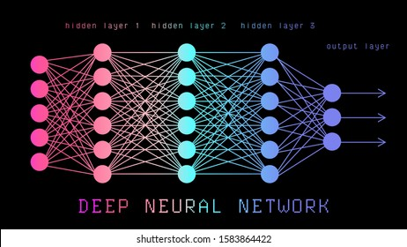

Zero-Shot Learning
An Overview of SOTA Techniques (TARS, BART)
CS725: Foundations of Machine Learning
Instructor: Prof. Preethi Jyothi
Who are The Unemployed?
Mahim Katiha
Subhadeep Chaudhuri
Saptarshi Majumder
The Unemployed
19i190002
19i190010
19i190011

Slide 2

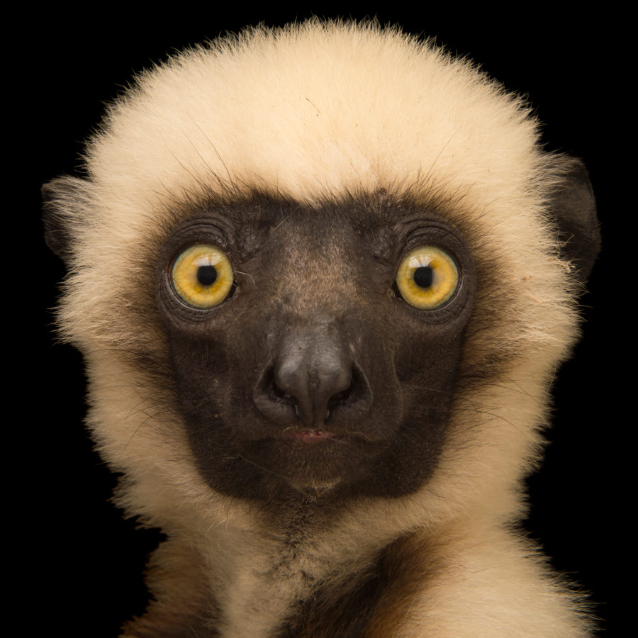
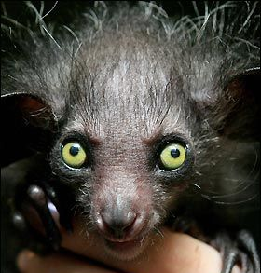
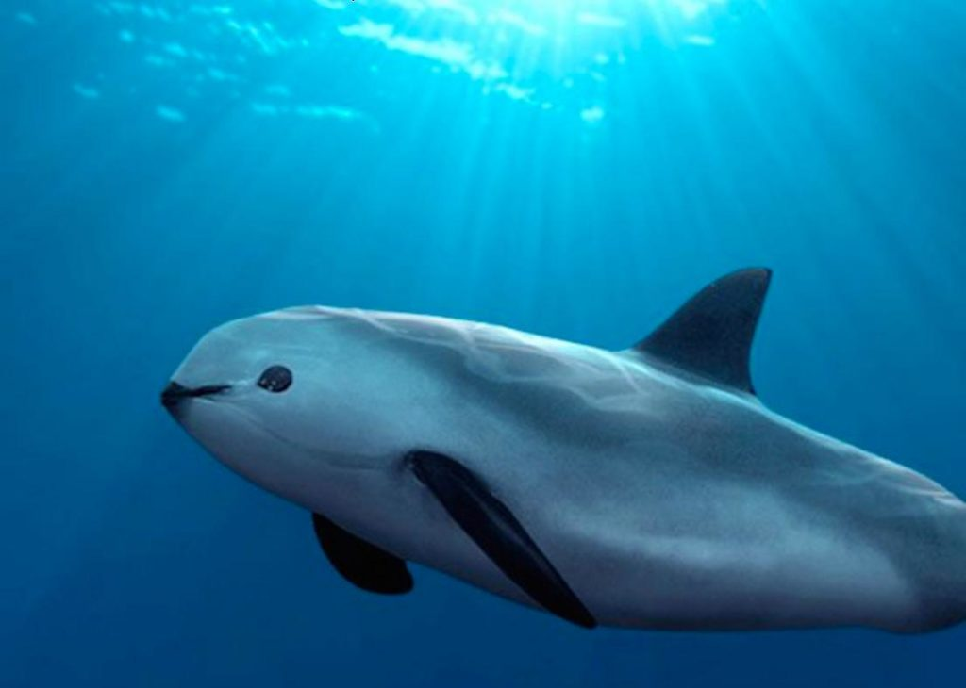
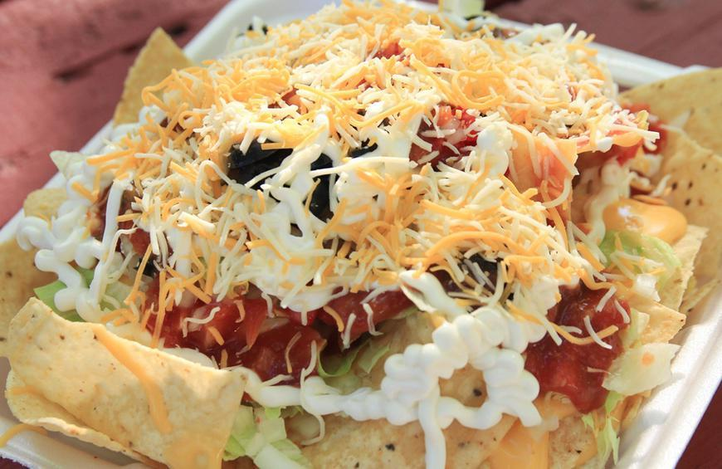
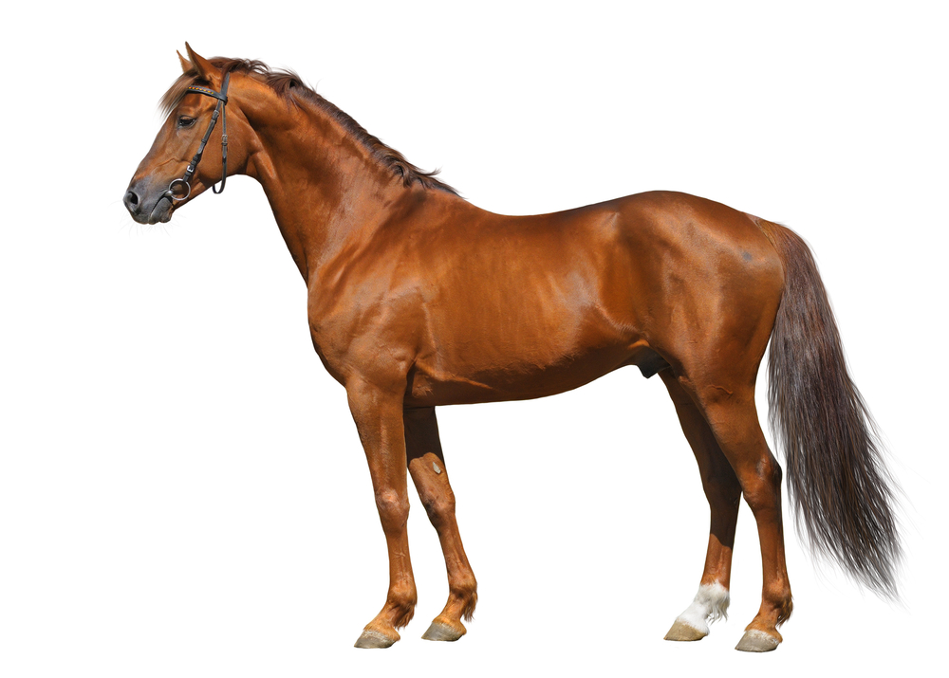
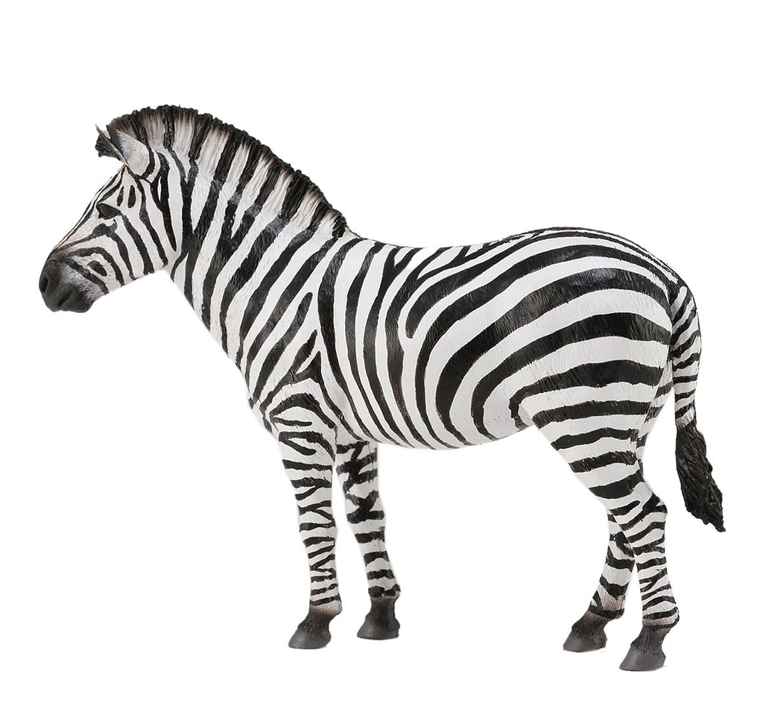
Introduction
TASK : Recognize the Vaquita
Almost impossible to guess, right?
Solution : Semantic Transfer
Domain Ontology
Vaquita := triangular dorsal fin, rounded head, no distinguished beak
Wikipedia Page
Pattern recognition with no training examples
White horse with black stripes
Zero-Shot Learning:
Solved by semantic transfer

Slide 3
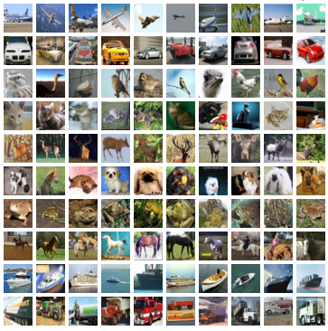

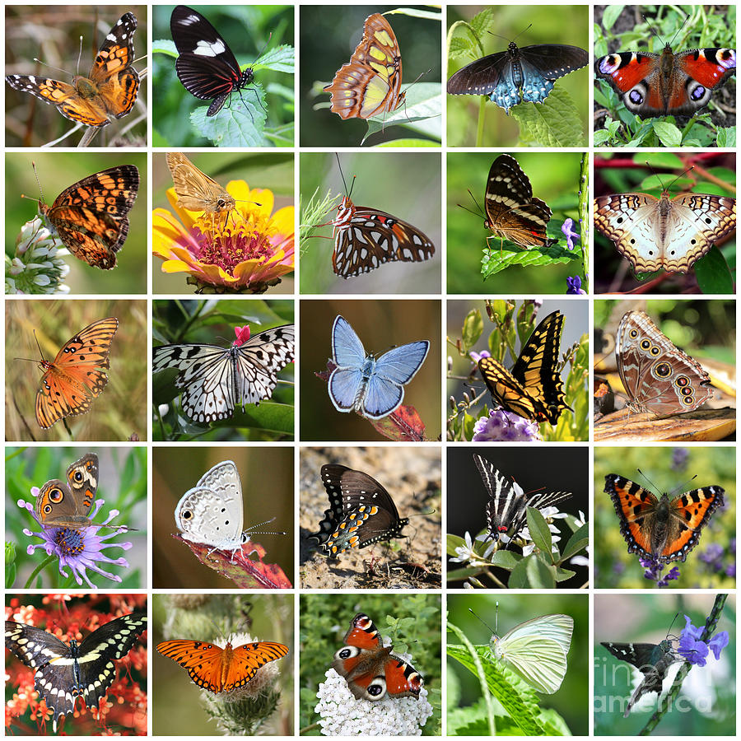
Why Zero-Shot Learning?
Vast and growing number of categories
Collecting and annotating each such example is impossible
New categories always emerging. Eg, Striped Hairstreak & Elusive Prince discovered in July ’21
Examples
Object Recognition
Cross-lingual Dictionary Induction
Every word is a category
Every pair of languages
English: Learn
Russian: учиться
German: Lernen
NLP
… any many more

Slide 4

Attention in
Transformers

Slide 5
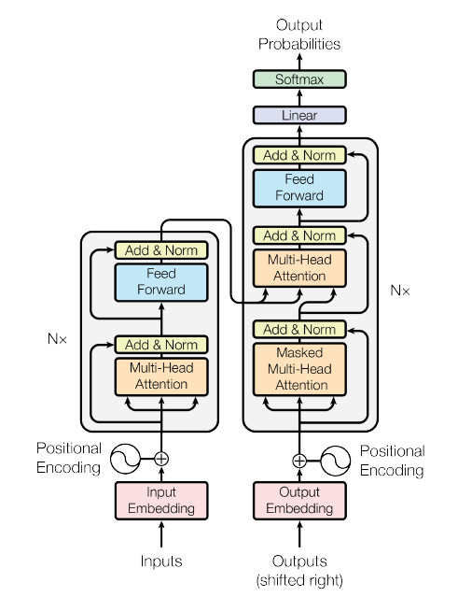
Building Blocks of The Transformer
TRANSFORMER BLOCK
ENCODER
DECODER
Each block has two sub layers:
Multi-head Self-Attention
Two layer fully-connected feed-forward network
In addition, we have the following:
Residual connections
Layer Normalization
Positional Encoding of the input sequence
Decoder block has an additional attention layer
“Attention Is All You Need”, Vaswani et. al. (2017)

Slide 6
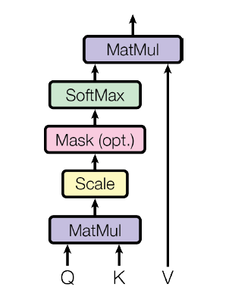
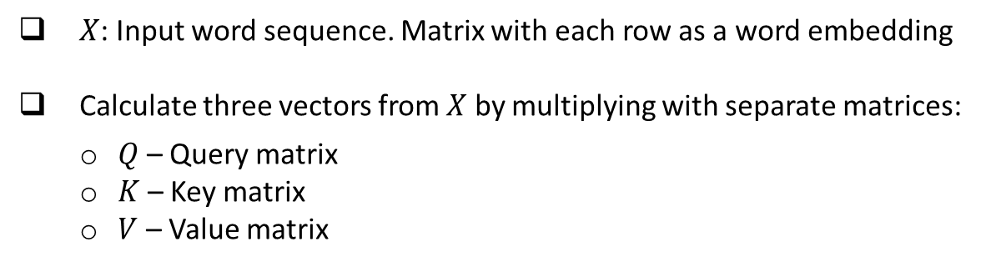
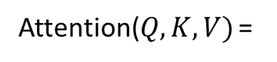
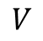
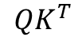
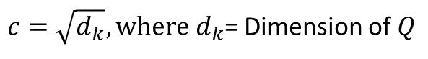
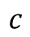
Self-Attention
$X$: Input word sequence. Matrix with each row as a word embedding
Calculate three vectors from $X$ by multiplying with separate matrices:
$Q$– Query matrix
$K$ – Key matrix
$V$ – Value matrix
Aim: To find the important representation from the Keys ($K$) for the Queries ($Q$)
Attention($Q,K,V)$ =
softmax
(
$$QK^{T}$$
)
$c=\sqrt{d_{k}},{where d}_{k}$= Dimension of $Q$
$$c$$
$$V$$
Steps:
Score each word in an input sentence against a selected word
Scale and pass through softmax to create a probability distribution
Multiply value matrix $V$by the softmax score

Slide 7
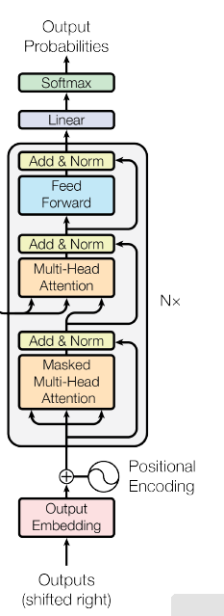
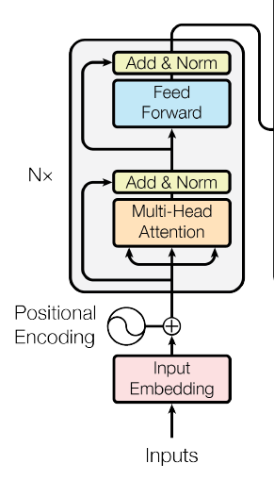
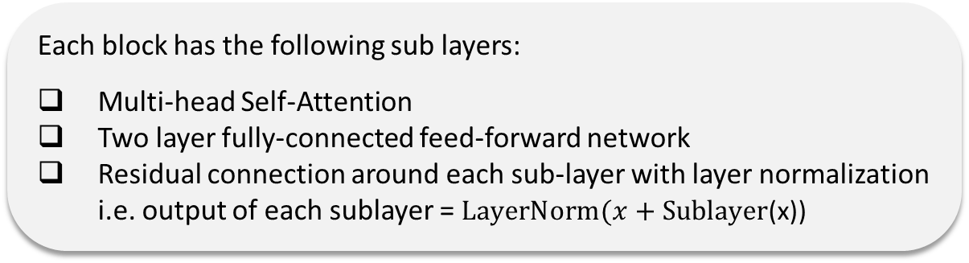
Encoder Part of The Transformer
Input words in the sentence are processed parallelly
Embedding of each input word added with a positional embedding
Multiple encoder blocks stacked on top of one another (6 in the paper)
Each block has the following sub layers:
Multi-head Self-Attention
Two layer fully-connected feed-forward network
Residual connection around each sub-layer with layer normalization i.e. output of each sublayer = $LayerNorm(x+Sublayer$(x))
Output from the encoder part (top encoder block) to be used in the decoder attention layer

Slide 8
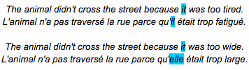
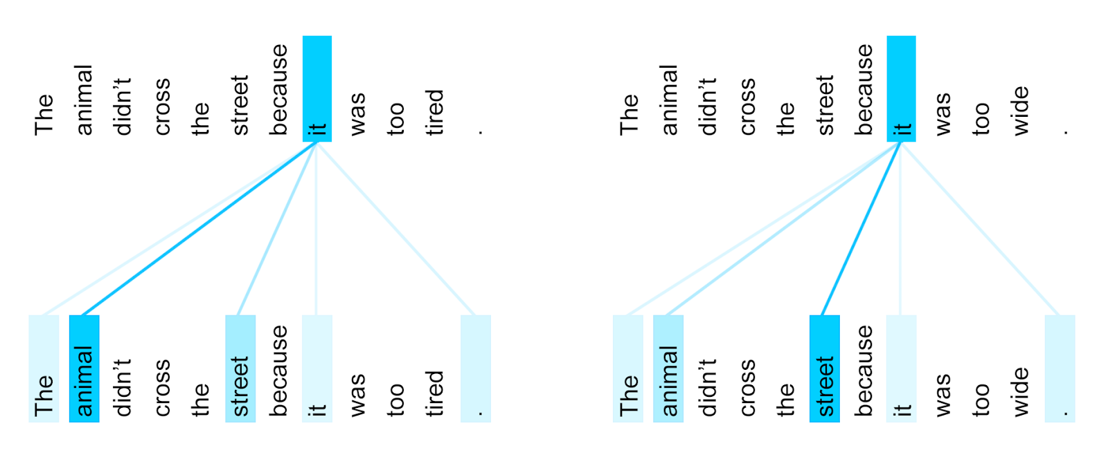
Transformer in Action
Visualizing what words the encoder attended to when computing the final representation for the word “it”
Transformer: A Novel Neural Network Architecture for Language Understanding, Google AI Blog

Slide 9
Zero-Shot Learning

Slide 10
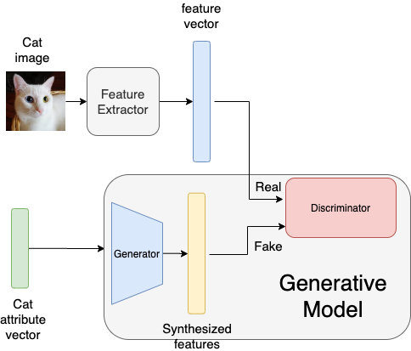
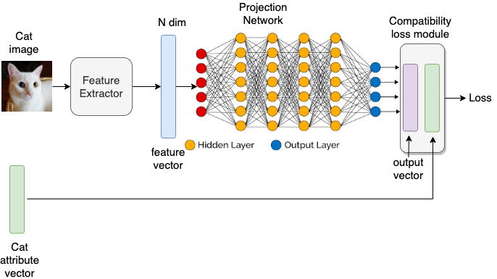
Approaches to ZSL
There are two common approaches used to solve the zero-shot recognition problems.
Embedding-based Approach
Generative Model-based Approach
Snips taken from :
https://www.kdnuggets.com/2021/04/zero-shot-learning.html

Slide 11
Models
and Experiments

Slide 12
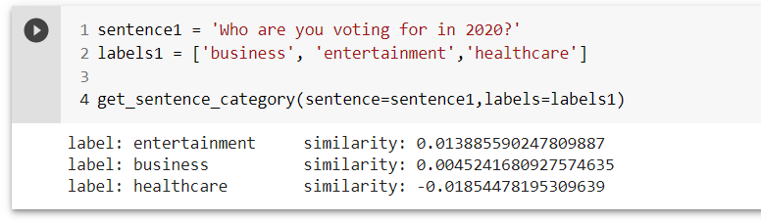
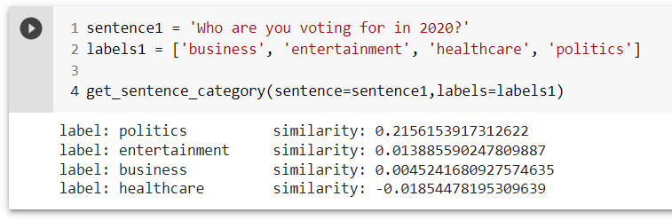
Simple Experiment Performed
Adding a new label 'politics' to find similarity of the sentence with new label or category
Indeed, higher similarity found!

Slide 13
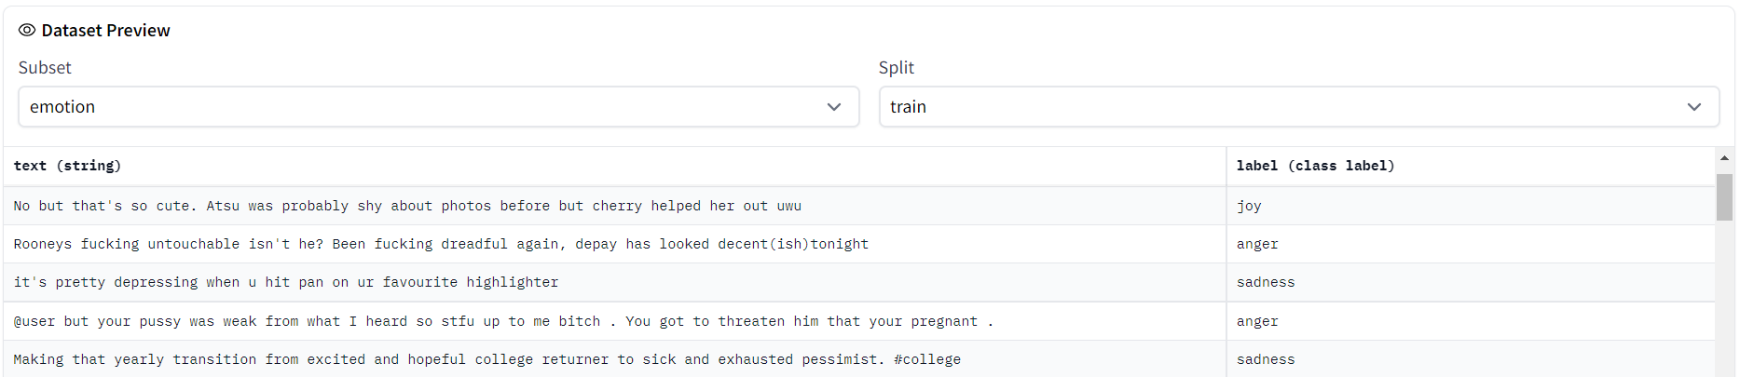
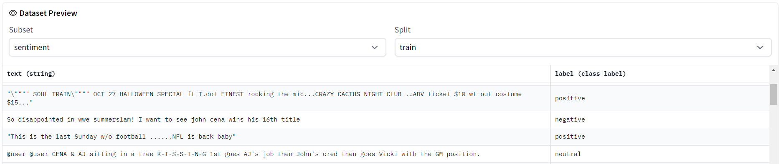
Data Set Considered
1
Yahoo! Answers topic classification
HuggingFace: ‘yahoo_answers_topics’
Constructed from the main Yahoo! Answers dataset, using 10 largest main categories.
Each class contains 140,000 training samples & 6,000 testing samples.
2
TweetEval
HuggingFace: ‘tweet_eval’
TweetEval consists of seven heterogenous tasks in Twitter, all framed as multi-class tweet classification.
2a
'tweet_eval (emotion)'
2b
'tweet_eval (sentiment)'
Snips taken from Hugging Face dataset repo:
https://huggingface.co/datasets/tweet_eval

Slide 14

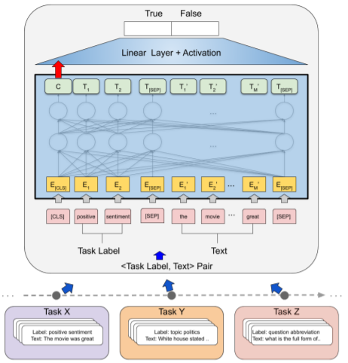
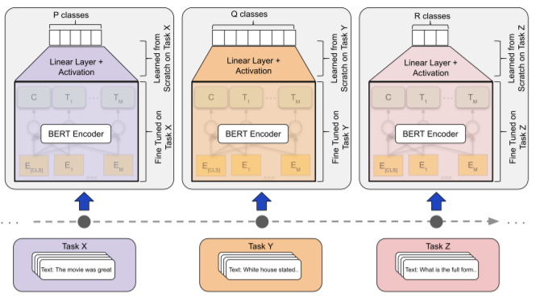

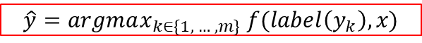
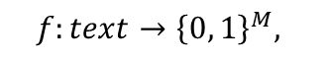
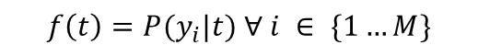

Models Considered
TARS Classifier
$$f:text→{\left\{0, 1\right\}}^{M},$$
$$f\left(t\right)=P(y_{i}|t) ∀ i ∈ \{1…M\}$$
What if new label added?
Learned linear layer becomes useless
Solution?
Factorize the text classification problem into a generic binary classification task
$$f:<task label, text>→\{0, 1\}$$
$$i.e., f(label(yi), t) = P\left( True\right|y_{i}, t) ∀ i ∈ \{1…M\}$$
$$\hat{y}=argmax_{k∈\left\{1, … ,m\right\}} f(label\left(y_{k}\right), x)$$
Drawback: Requires more forward pass since each text sequence will be evaluated against each label
BART Classifier
Bidirectional and Auto-Regressive Transformer (BART) is a Transformer combining
Bidirectional Encoder (e.g., BERT)
Autoregressive Decoder (e.g., GPT) into Seq2Seq model
BART can be seen an a demonising auto encoder as it is trained by
corrupting text with an arbitrary noising function, and
learning a model to reconstruct the original text.

Slide 15
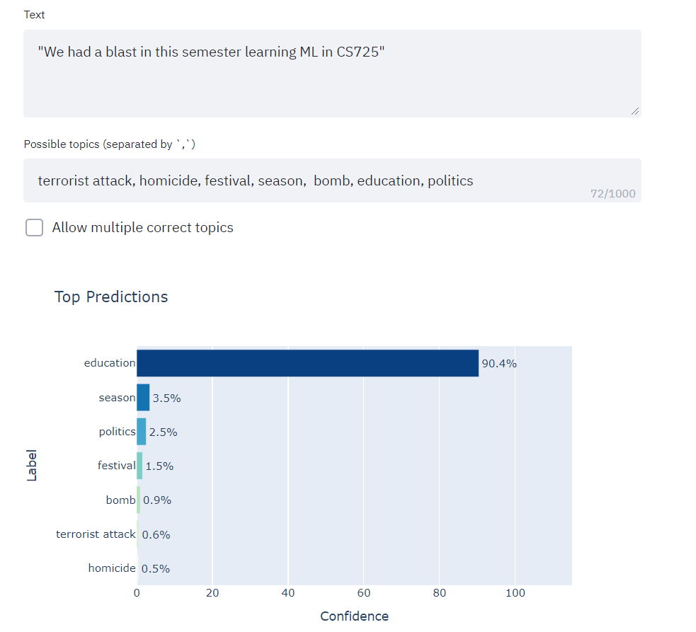
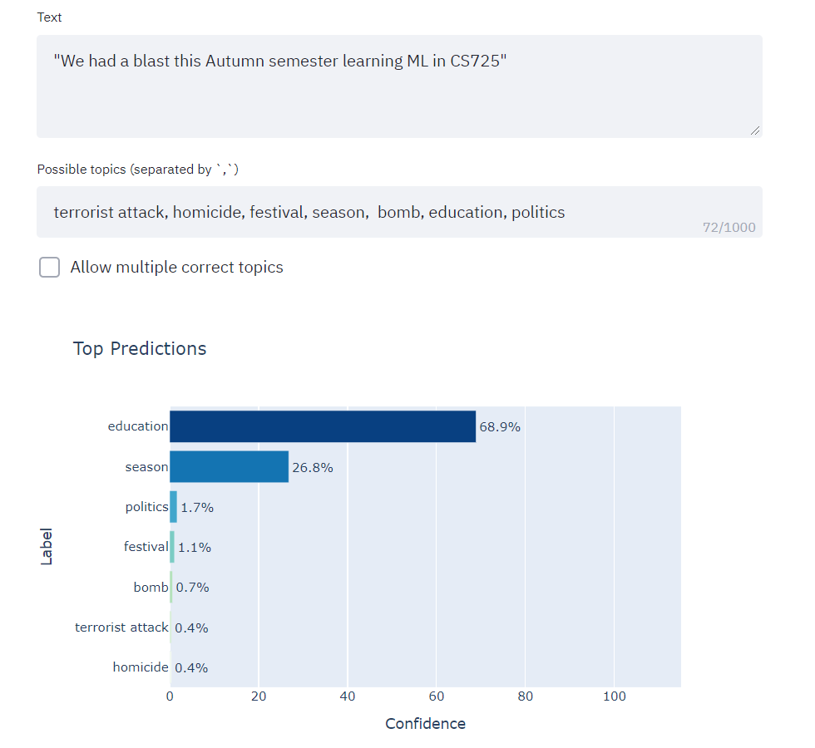
Quick Demo from HuggingFace
For the online demo using Hugging Face Model hub, please click here
Snips taken from Hugging Face Model hub for ZSL:
http://35.208.71.201:8000/

Slide 16
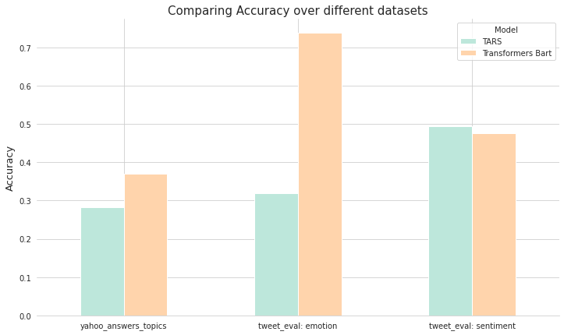
Comparative Results
Models considered
1
TARS
2
BART
Who performs better?
1
2
Yahoo! Answers Topic Classification
TweetEval: Emotion
TweetEval: Sentiment

Slide 17
In Conclusion…

Slide 18
References
Papers + Blogs
Reference [1] “Benchmarking Zero-shot Text Classification: Datasets, Evaluation and Entailment Approach”, Yin et.al.
Reference [2] “Task-Aware Representation of Sentences for Generic Text Classification”, Halder et.al.
Reference [3] “Attention Is All You Need”, Vaswani et. al.
Reference [4] “BERT: Pre-training of Deep Bidirectional Transformers for Language Understanding”, Devlin et. al.
Reference [5] Zero-Shot Learning in Modern NLP, Joe Davison Blog
Reference [6] Zero-Shot Learning
Reference [7] Adventures in Zero-Shot Text Classification, Yves Peirsman
Videos
Reference [6] Zero-Shot Learning - Dr. Timothy Hospedales, Yandex School of Data Analysis Conference
Reference [7] Zero Shot Classification with HuggingFace Pipeline
Code Repositories
Reference [8] Code reference 1

Slide 19
Contribution Of Members
Member | Mahim | Subhadeep | Saptarshi
Task
Main Paper
Reference Papers
Code
Slides
Content Mining
Report
Lead
Support

Slide 20


